Slide 1


Minor Project
Title:
Sports Connect
Presented by:
Sruti Sikha Goswami R2142220287 CSE CCVT (B2) Harsh Jindal R2142220506 CSE CCVT (B2)
Anil Joshi R2142220430 CSE CCVT (B4) Garvit Goel R2142220496 CSE CCVT (B3)
Guided by:
Dr. Panduranga Ravi Teja
School of Computer Science

Slide 2
Content
Introduction
Problem Statement
Motivation
Objectives
Tech Stack
Methodology
Area of Application
Data Collection & Input Format
Inter-Process Communication
Programming Concepts
Libraries Used
Working Demonstration

Slide 3
1. Introduction
In India, cricket dominates the sports culture, overshadowing awareness and enthusiasm for other sports.
Despite India's participation in various global sporting events, the general public's understanding of the diversity of sports, especially those in the Olympics, is limited.
This strong preference for cricket affects the growth and development of other sports, resulting in fewer opportunities for athletes in non-cricket disciplines.
The difference in India's strong performance in ICC cricket tournaments and its relatively modest success in the 2024 Olympics highlights this disparity.
There is a need for a comprehensive, user-friendly platform to:
Educate the public about various sports and their categories.
Engage users with content related to different sports.
Inform users about nearby sports academies and training centers.
Such a platform could help foster a more inclusive sports culture in India by encouraging interest in a variety of sports and supporting athletes across different disciplines.

Slide 4
2.Problem Statement
Despite participating in sports at the global level, the awareness of general public is lacking and is people are highly tilted only towards cricket in India. Many people are unaware of the diverse categories of sports featured in Olympics. This lack of awareness hampers the growth and development of other sports in India reducing opportunities for athletes. This is quite evident because India performs very well in ICC but on the other hand being such a big nation India’s performance in Olympics 2024 as compared to other countries is not that good. To bridge this gap, there is a need for a comprehensive, user -friendly platform that educates, engages and informs about the various sports academies located near the user, ultimately fostering a more inclusive sports culture in India.

Slide 5
3.Motivation
Lack of Sports Diversity: Despite India's participation in global events like the Olympics, there is limited understanding of the variety of sports, leading to a skewed sports culture.
Impact on Athletes: The negligence for various sports by society hinders the athelete’s growth and potential.
Disparity in Performance: India's strong performance in cricket contrasts with its modest success in the Olympics, highlighting the need for more balanced support across sports.
Need for a Platform: A user-friendly platform is essential to educate the public about various sports, engage them with diverse content, and inform them about nearby sports academies and training centers.
Fostering Inclusivity: Such a platform could promote a more inclusive sports culture in India, encouraging interest in multiple sports and supporting athletes in all disciplines.

Slide 6
4. Objectives
To develop a user friendly interface
Integrate a location based API
Design an optimized and scalable database sytem.

Slide 7
5.Technology Stack
Version Control
GitLabs
Development
Backend – Java
Frontend – HTML, CSS and Javascript
Java Version – Java 11
Database
MYSQL

Slide 8
6.Methodology
Requirement Analysis:
Problem Identification
Identifying User needs
Architecture Design:
Develop a design of the architecture of the platform by choosing cloud-based architecture, serverless infrastructure for
. scalability and performance
Database Design:
Design a robust database to store information about various sports, user profiles and sports academies
Content Deployment:
Sports information compilation: gather and organize detailed information about various ports including rules, categories and key players
Platform Development:
Frontend development: Design a user friendly interface using technologies like HTML, CSS and Javascript Frameworks Backend development: Design a database and connectivity using java and serverless computing services like j Iava integration: to locate near by sports academies

Slide 9
Algorithms to be used:
Geolocation Algorithm:
Proximity Search: Use geospatial algorithms to identify and recommend nearby sports academies, training centers, and events based on the user’s location.

Slide 10

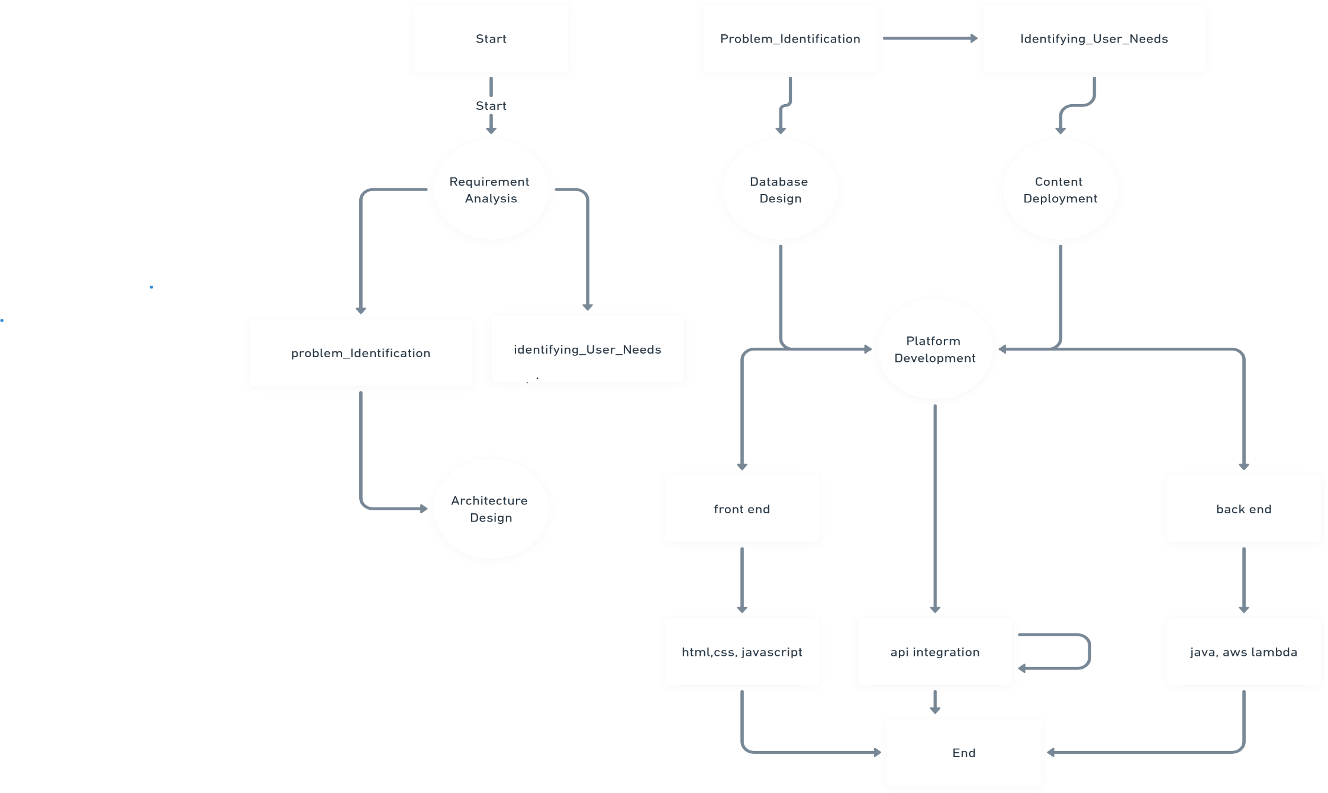
6. Methodology (contd.)

Slide 11
7.Swot Analysis
Strengths:
Scalability & Flexibility.
Content Richness
Modern Tech Stack
Algorithms Weaknesses:
Algorithm Complexity
Data Security Opportunities:
Growing Sports Market
Partnerships Threats:
Competition
Data Privacy
Technology Risks

Slide 12
8.Area of Application
The Sports Connect project has broad applications within the sports industry, particularly for athletes, sports enthusiasts, and sports academies aiming to increase accessibility to various sports beyond cricket. It serves as a valuable tool for individuals looking to discover training centers, events, and information on different sports, helping to foster sports awareness and engagement across India. Additionally, it can be adapted to serve international markets or other regions with similar needs in promoting diverse sports and connecting athletes to opportunities.

Slide 13
9. Data Collection & Input Format
To provide users with accurate information and recommendations, Sports Connect relies on several key datasets:
User Profile Data: Includes users' sports interests, preferences, and location data. This data helps in offering personalized recommendations for sports events, academies, and content.
Sports and Event Information: Contains detailed data on various sports, training centers, academies, events, and locations. This enables users to find nearby academies and upcoming sports events.
Operational Data: Includes information on sports academy services, training schedules, fees, and available facilities. This data supports users in making informed choices based on academy offerings.
Input Format
User Input: Users enter their sports interests, preferred training locations, and other preferences. This data is stored in their profile and used to enhance recommendations.
Automated Processing: The system utilizes geolocation and recommendation algorithms to suggest relevant sports academies, events, and sports content, based on user preferences and location.
By integrating these datasets and technical components, Sports Connect ensures a user-centric experience, providing athletes and sports enthusiasts with valuable information and tailored recommendations to meet their sporting needs.

Slide 14
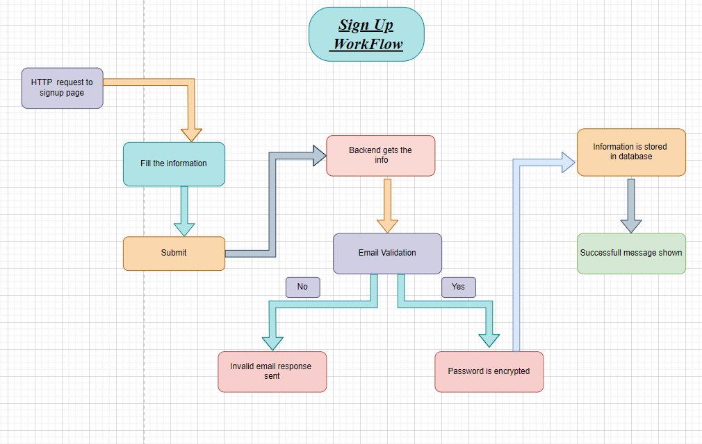

Slide 16
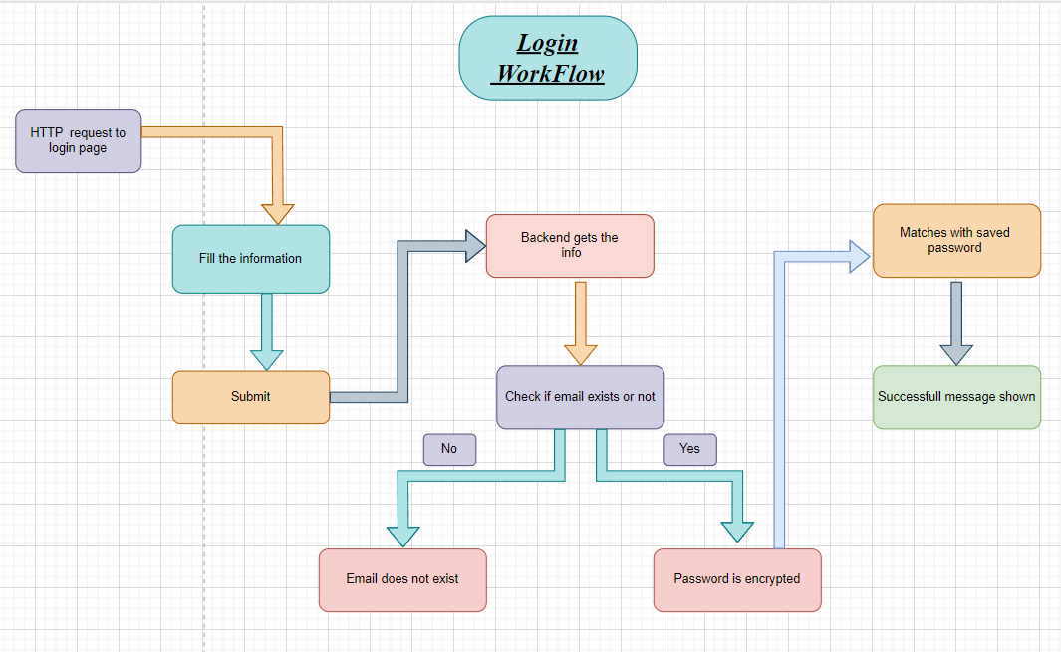

Slide 17
10. Inter-Process Communication
Methods to allow communication and create real time connection between the NodeJS server and MongoDB database.
Real Time API Interaction with form and sending mail to the user when registering.
Interaction between the form and the database to verify the validity of the email stored in the database.
Real time Table creation for storing the data of customer.
Validating and throwing errors in real time via validating the details input in the form.

Slide 18
11. Programming Concepts
Frontend Development:
HTML: Structure of the web pages
CSS: Styling of the web pages
Backend Development:
Java: Server-side scripting language to handle the requests
Form Handling: Processing user inputs from login and signup forms
API: For handling the request between different modules
Database Management:
MYSQL : Database management system to store user data
CRUD Operations: Create, Read, Update, Delete operations on user data

Slide 19
12. Programming Concepts(contd)
Password Security:
Password Encryption: Using functions like password hash() for hashing passwords

Slide 20
13. Libraries used
Overall Stack:
Frontend:
Technologies: HTML, CSS, JavaScript (Vanilla).
Libraries: Simple usage of Fetch API and native DOM manipulation techniques.
Backend:
Framework: Java (Spring Boot).
Key Components:
RESTful API controllers (e.g., AcademyController.java, AppointmentController.java, UserController.java) to handle frontend-backend communication.
External API integration (e.g., DistanceCalculator.java for OSRM API).
Database:
Technology: MySQL.
Interaction: Spring Data JPA repositories (AcademyRepository.java, AppointmentRepository.java, UserRepository.java) are used for seamless CRUD operations on entities like Academy, Appointment, and User.

Slide 21
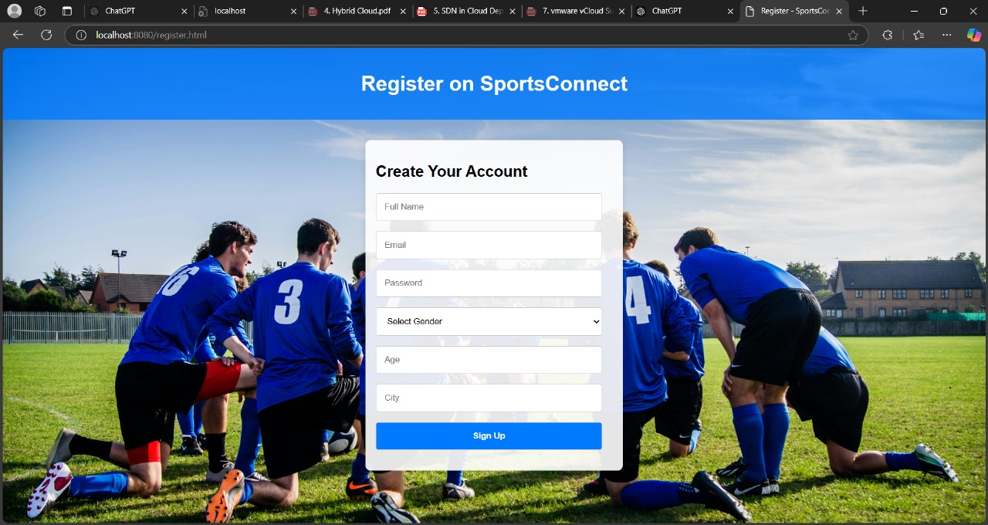
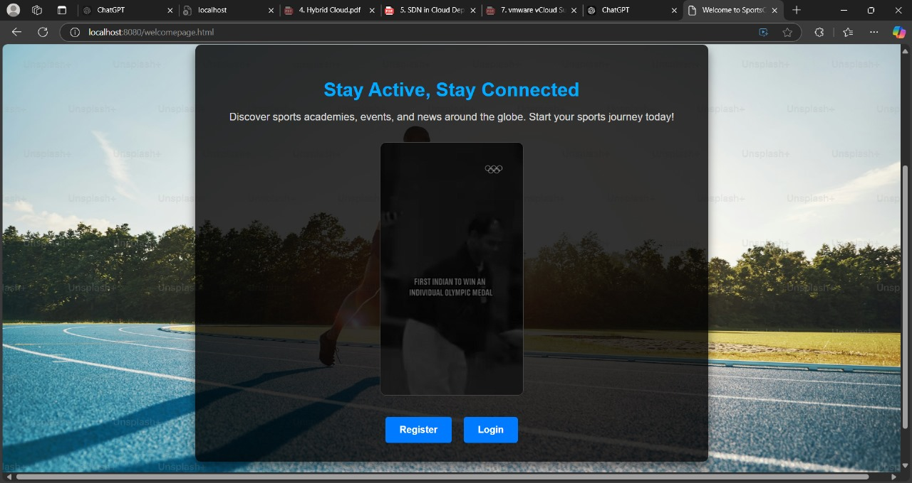
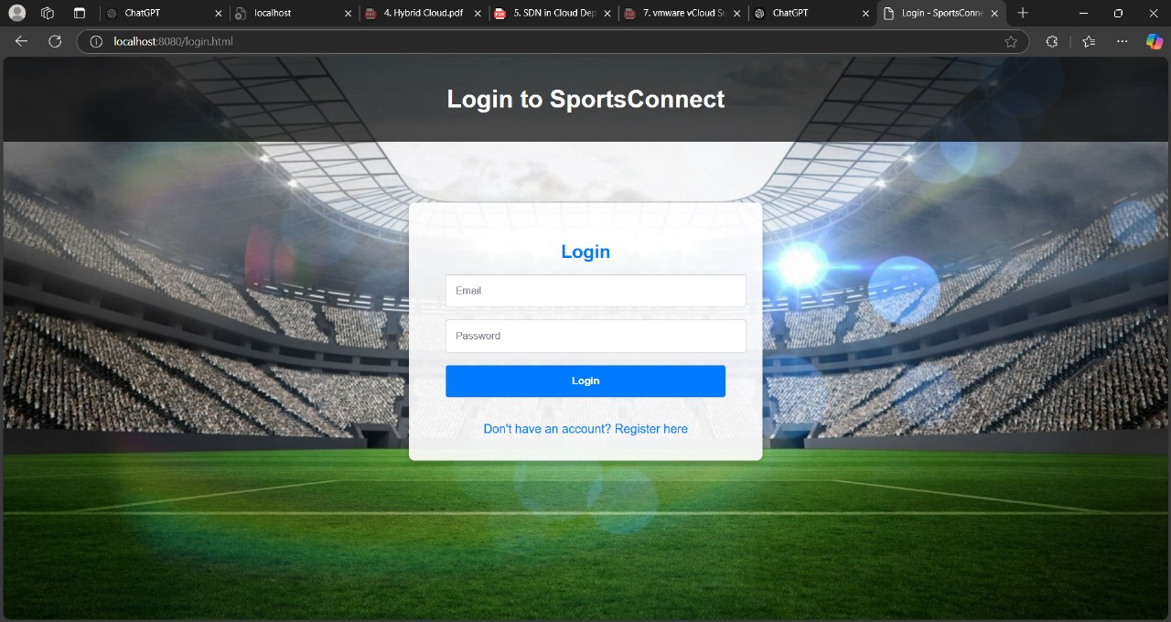
13. Working Demonstration

Slide 22
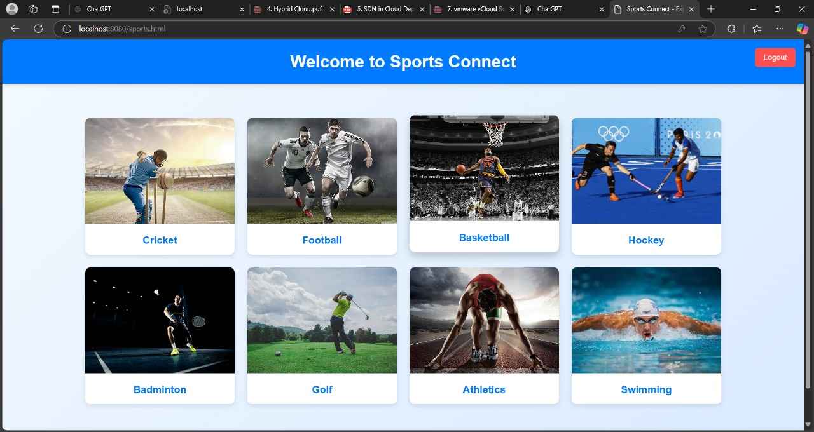
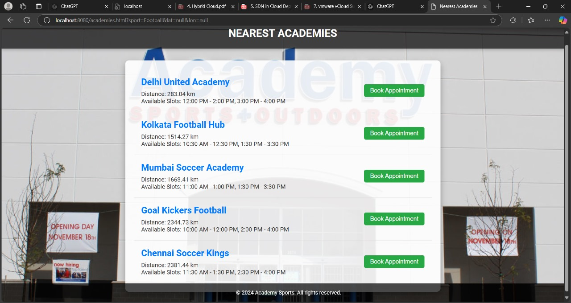
13. Working Demonstration

Slide 23
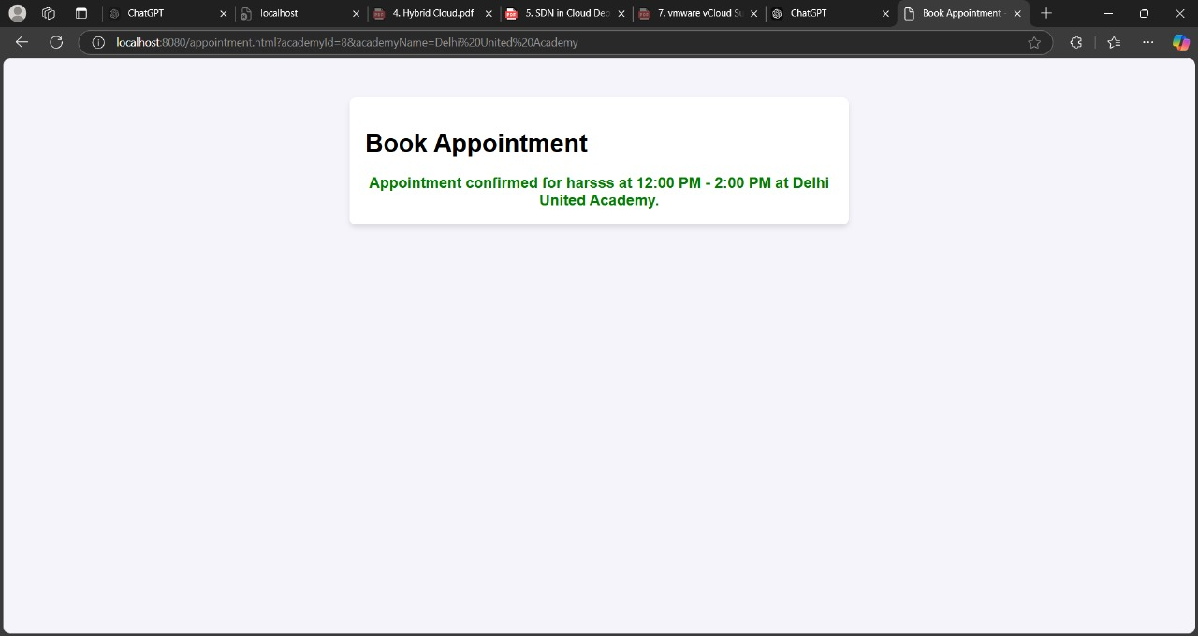
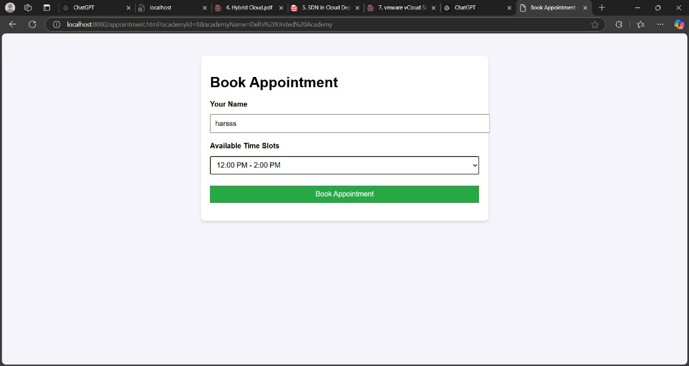
13. Working Demonstration

Slide 24
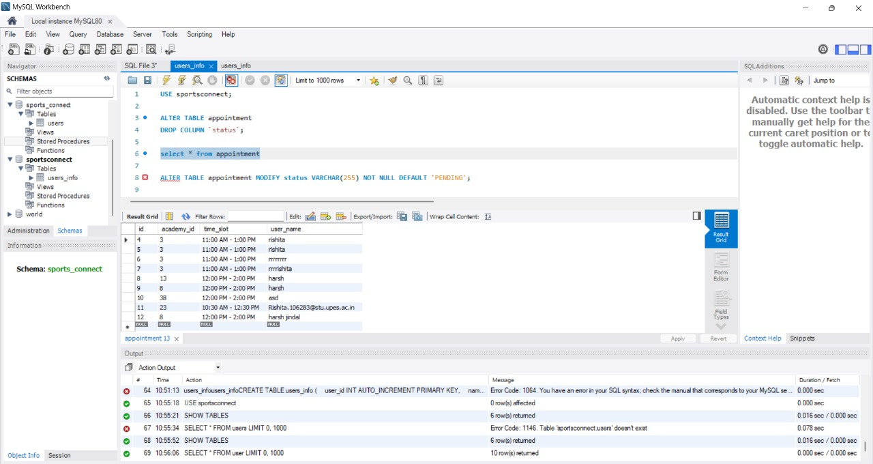
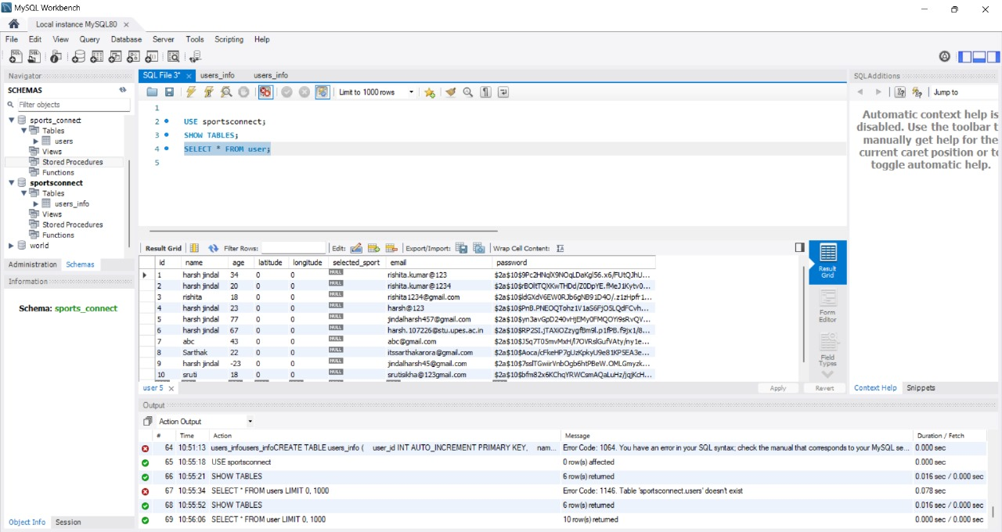
13. Working Demonstration

Slide 25

Thank You

